Slide 1
Pollinator Habitat Restoration Tools
Testing varied planting and herbicide application dates on imazapic-tolerant wildflowers
Client: Eleanor Schumacher

Slide 2
Introduction
Data Preprocessing
ANOVA Analysis
Visualization
Conclusion

Slide 3
Introduction
1

Slide 4

What encourages the strongest community assembly of desired species while minimizing weed pressure?

Slide 5
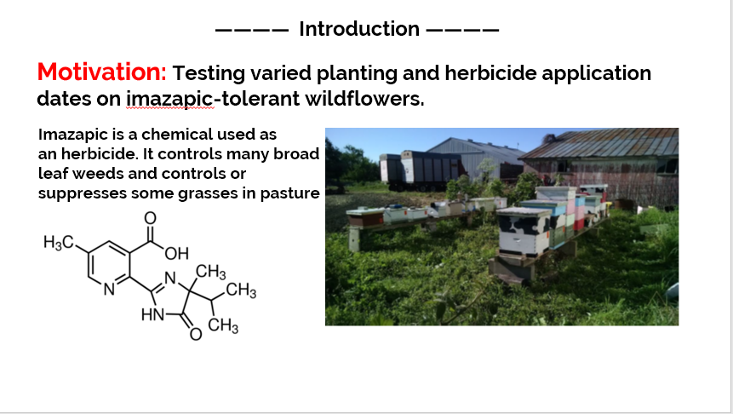

Slide 6
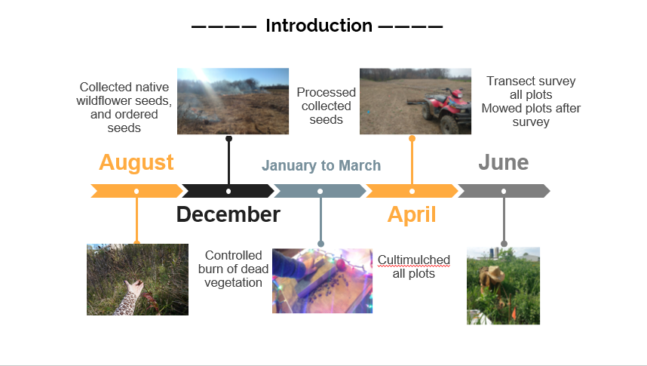

Slide 7
Experimental Design
• Two treatments: Does cold stratification contribute to the success of native plant establishment?
• Two seed mixes: How would a traditional “pollinator habitat” seed mix perform with imazapic application?
• Timing: How will plants respond to pre-emergent application of imazapic vs. post-emergent application?

Slide 8
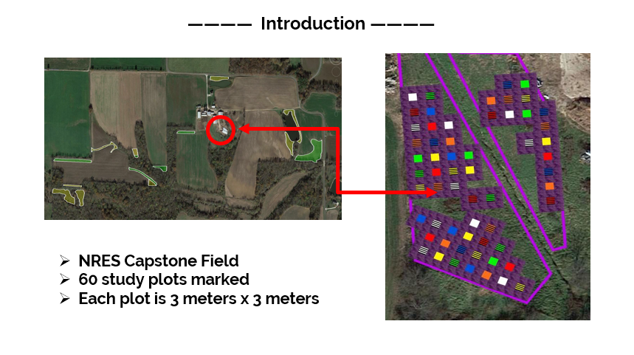

Slide 9
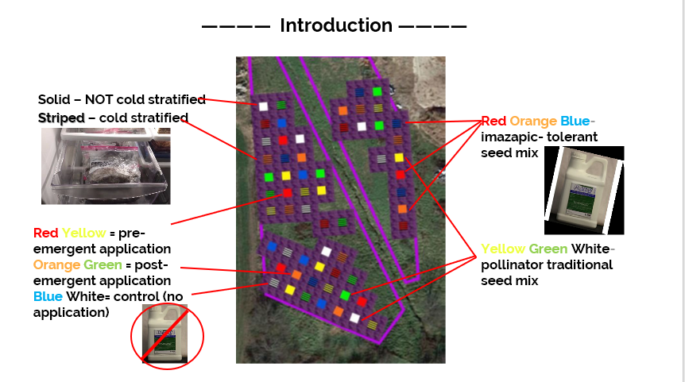

Slide 10
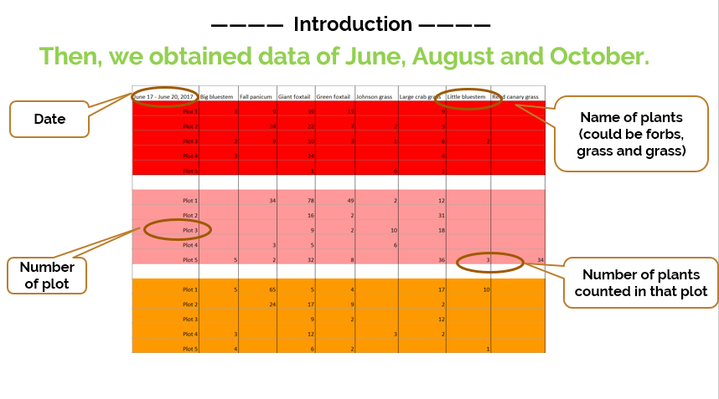
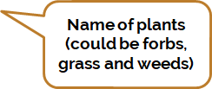

Slide 11
Data Preprocessing
2

Slide 12
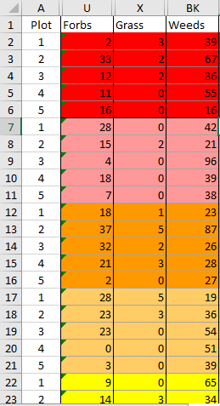
Plants which are not native but planted
Desired Grass = Bigbluestem+Littlebluestem
Undesired Grass + Weeds

Slide 13
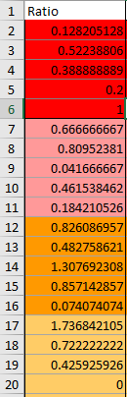
Target Variable-----Ratio
(Grass+Forbs)/(Grass+Forbs+Weeds)
Some denominators are 0, which produces some NAs;
Convert NAs into 0

Slide 14
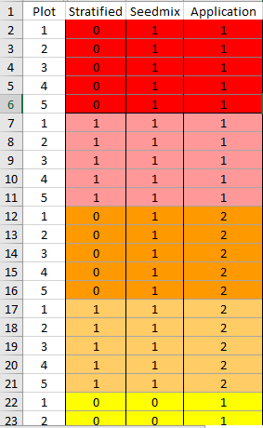
Stratified :
0: No Stratification
1: Cold Stratification
Seedmix :
0: Traditional pollinator seed mix
1: Plateau-tolerant pollinator seed mix
Application:(application time):
0: No herbicide application
1: Pre-emergent application
2: Post-emergent application

Slide 15
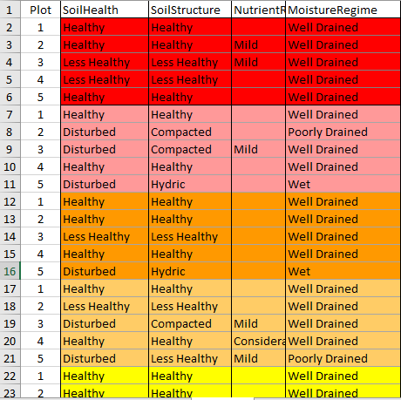
Soil Health:
Healthy, Less Healthy, Disturbed
Soil Structure:
Healthy, Less Healthy, Compacted
Nutrient Runoff:
Mild, Considerable；
For the missing values, converting them to “Normal”
Moisture Regime:
Well Drained, Poorly Drained, Wet

Slide 16
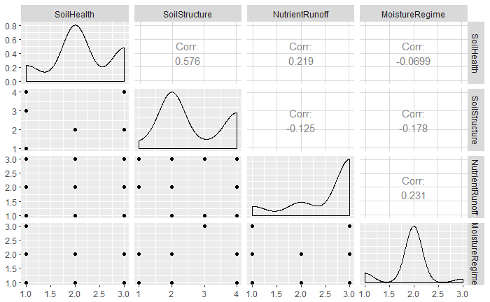
Correlation between soil variable:
SoilHealth
SoilStructure
NutrientRunoff
MoistureRegime

Slide 17
ANOVA Analysis
3

Slide 18
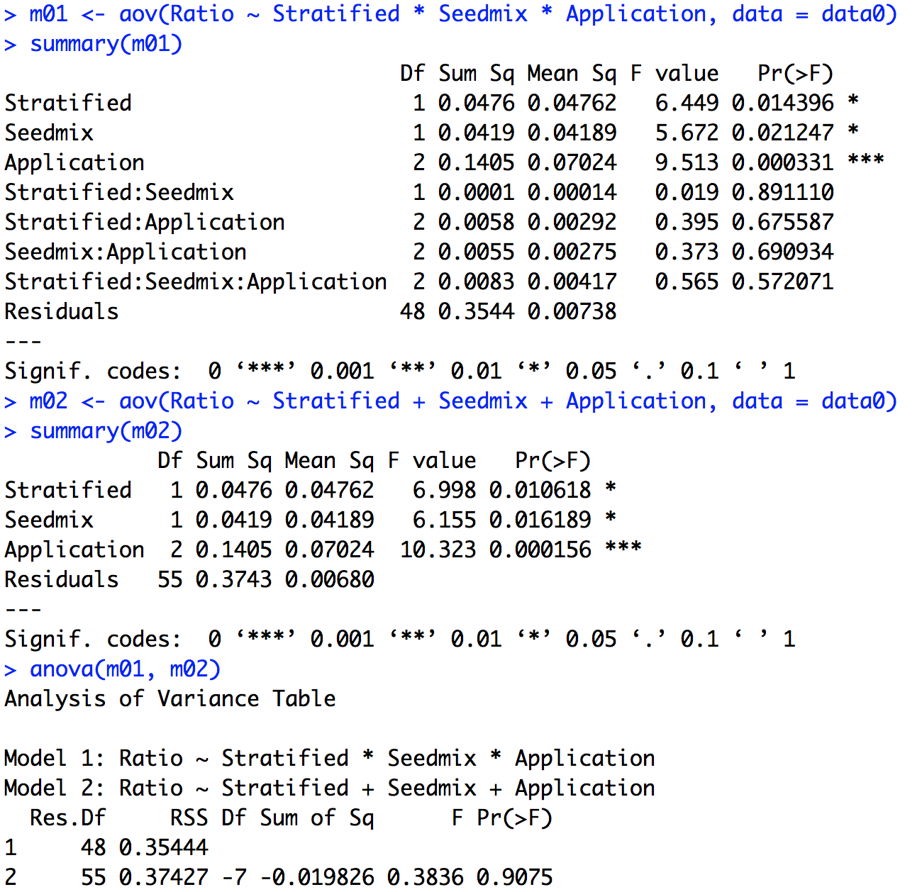
June
Fixed-effects ANOVA
Ratio ~ Stratified +
Seedmix +
Application

Slide 19
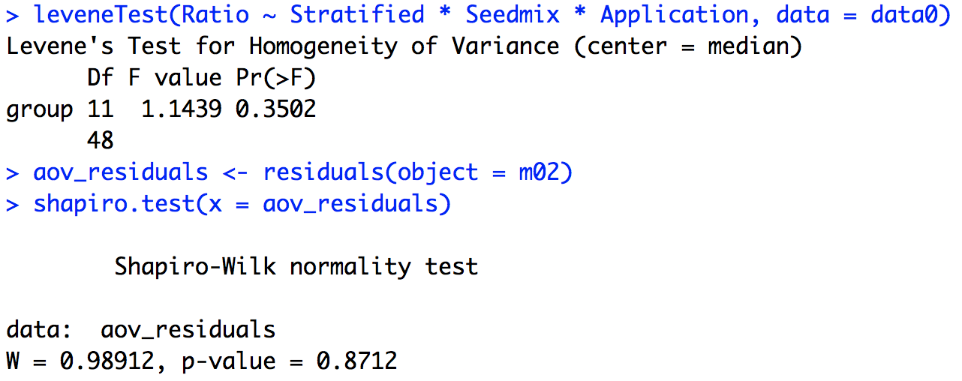
June
Fixed-effects ANOVA
Assumptions:
Homogeneity of variance
Levene test
Normality
Shapiro-Wilk test on the ANOVA residuals

Slide 20
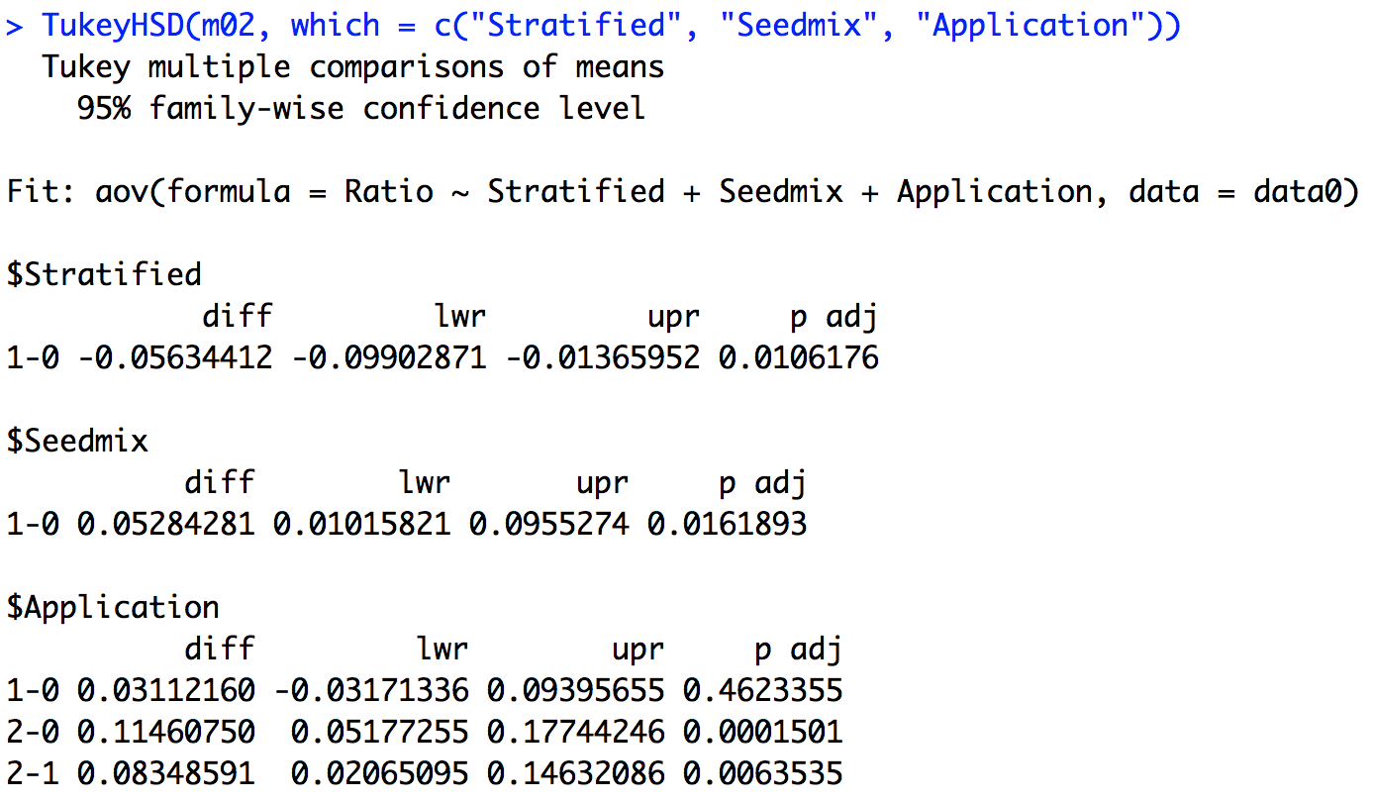
June
Tukey multiple pairwise-comparisons
Fixed-effects ANOVA
Ratio ~ Stratified +
Seedmix +
Application

Slide 21
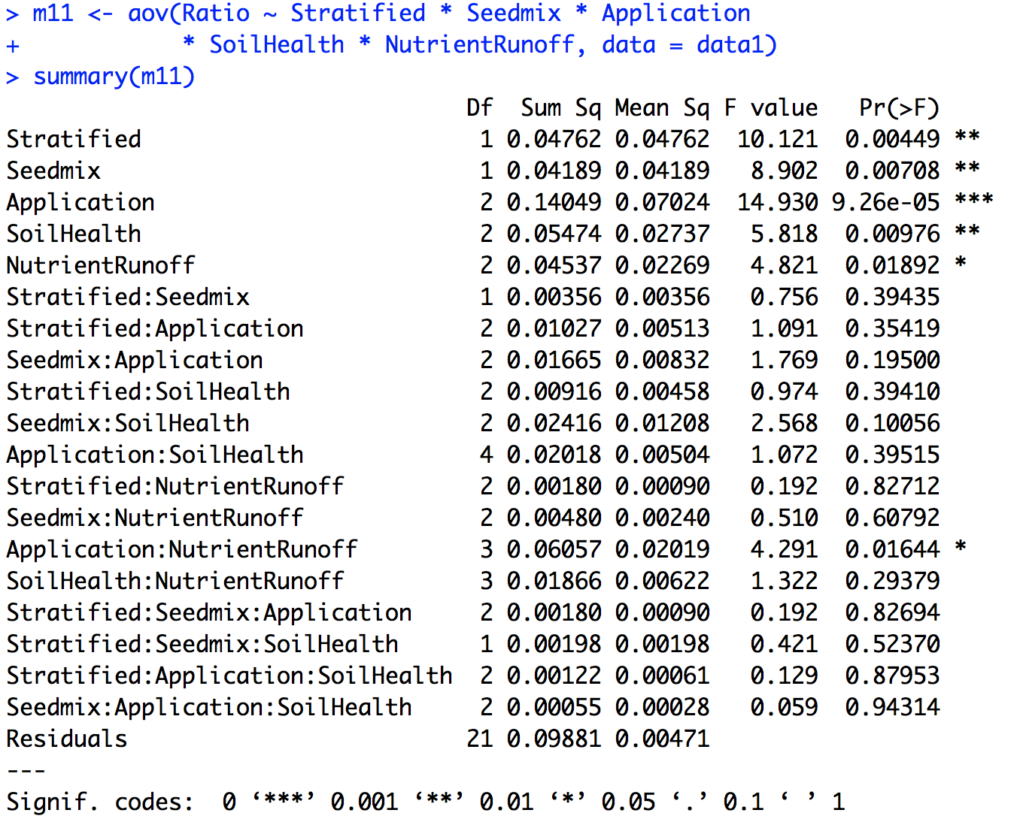
June
Fixed-effects ANOVA
Include soil condition.

Slide 22
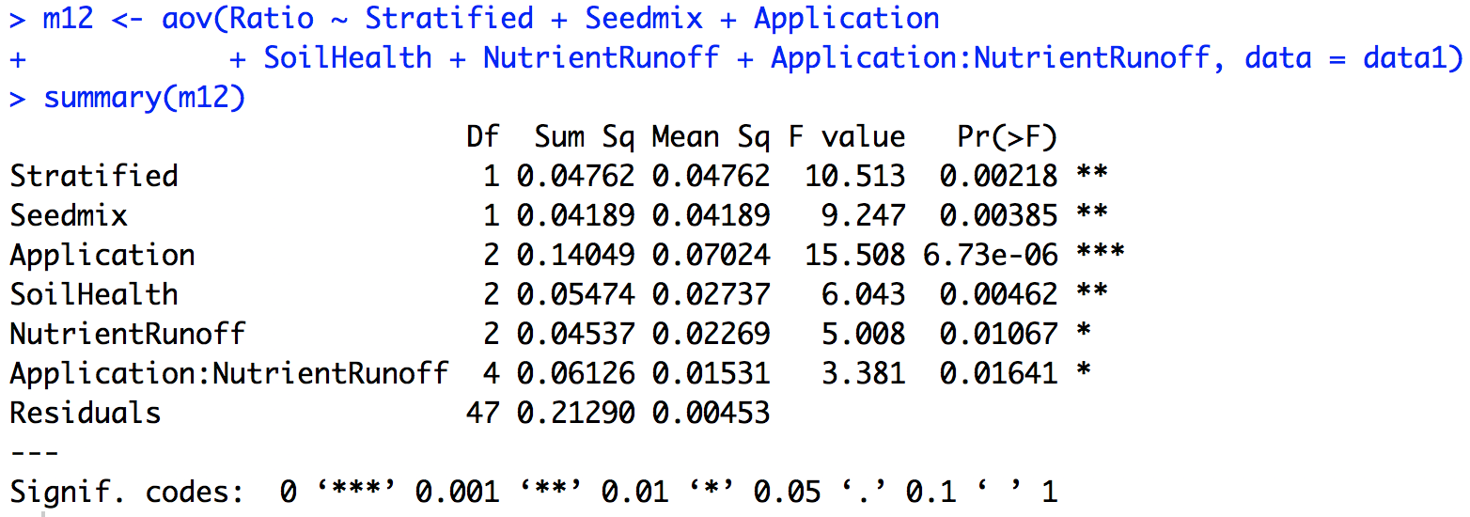
June
Fixed-effects ANOVA
Include soil condition.
Ratio ~ Stratified +
Seedmix +
Application +
SoilHealth +
NutrientRunoff +
Application:NutrientRunoff

Slide 23
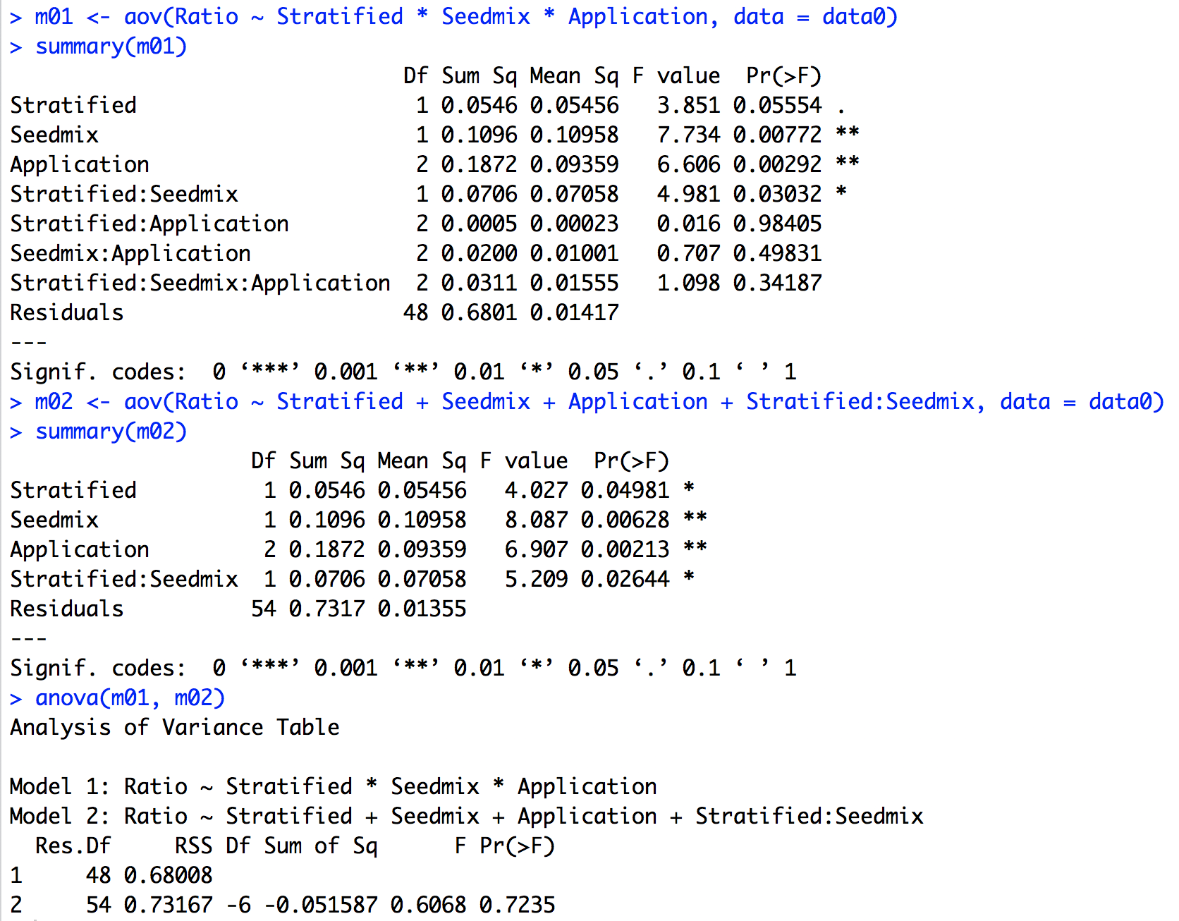
Aug
Fixed-effects ANOVA
Ratio ~ Stratified +
Seedmix +
Application +
Stratified:Seedmix

Slide 24
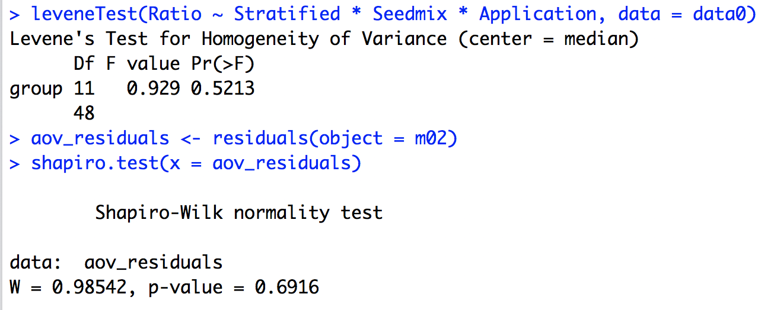
Aug
Fixed-effects ANOVA
Assumptions:
Homogeneity of variance
Levene test
Normality
Shapiro-Wilk test on the ANOVA residuals

Slide 25
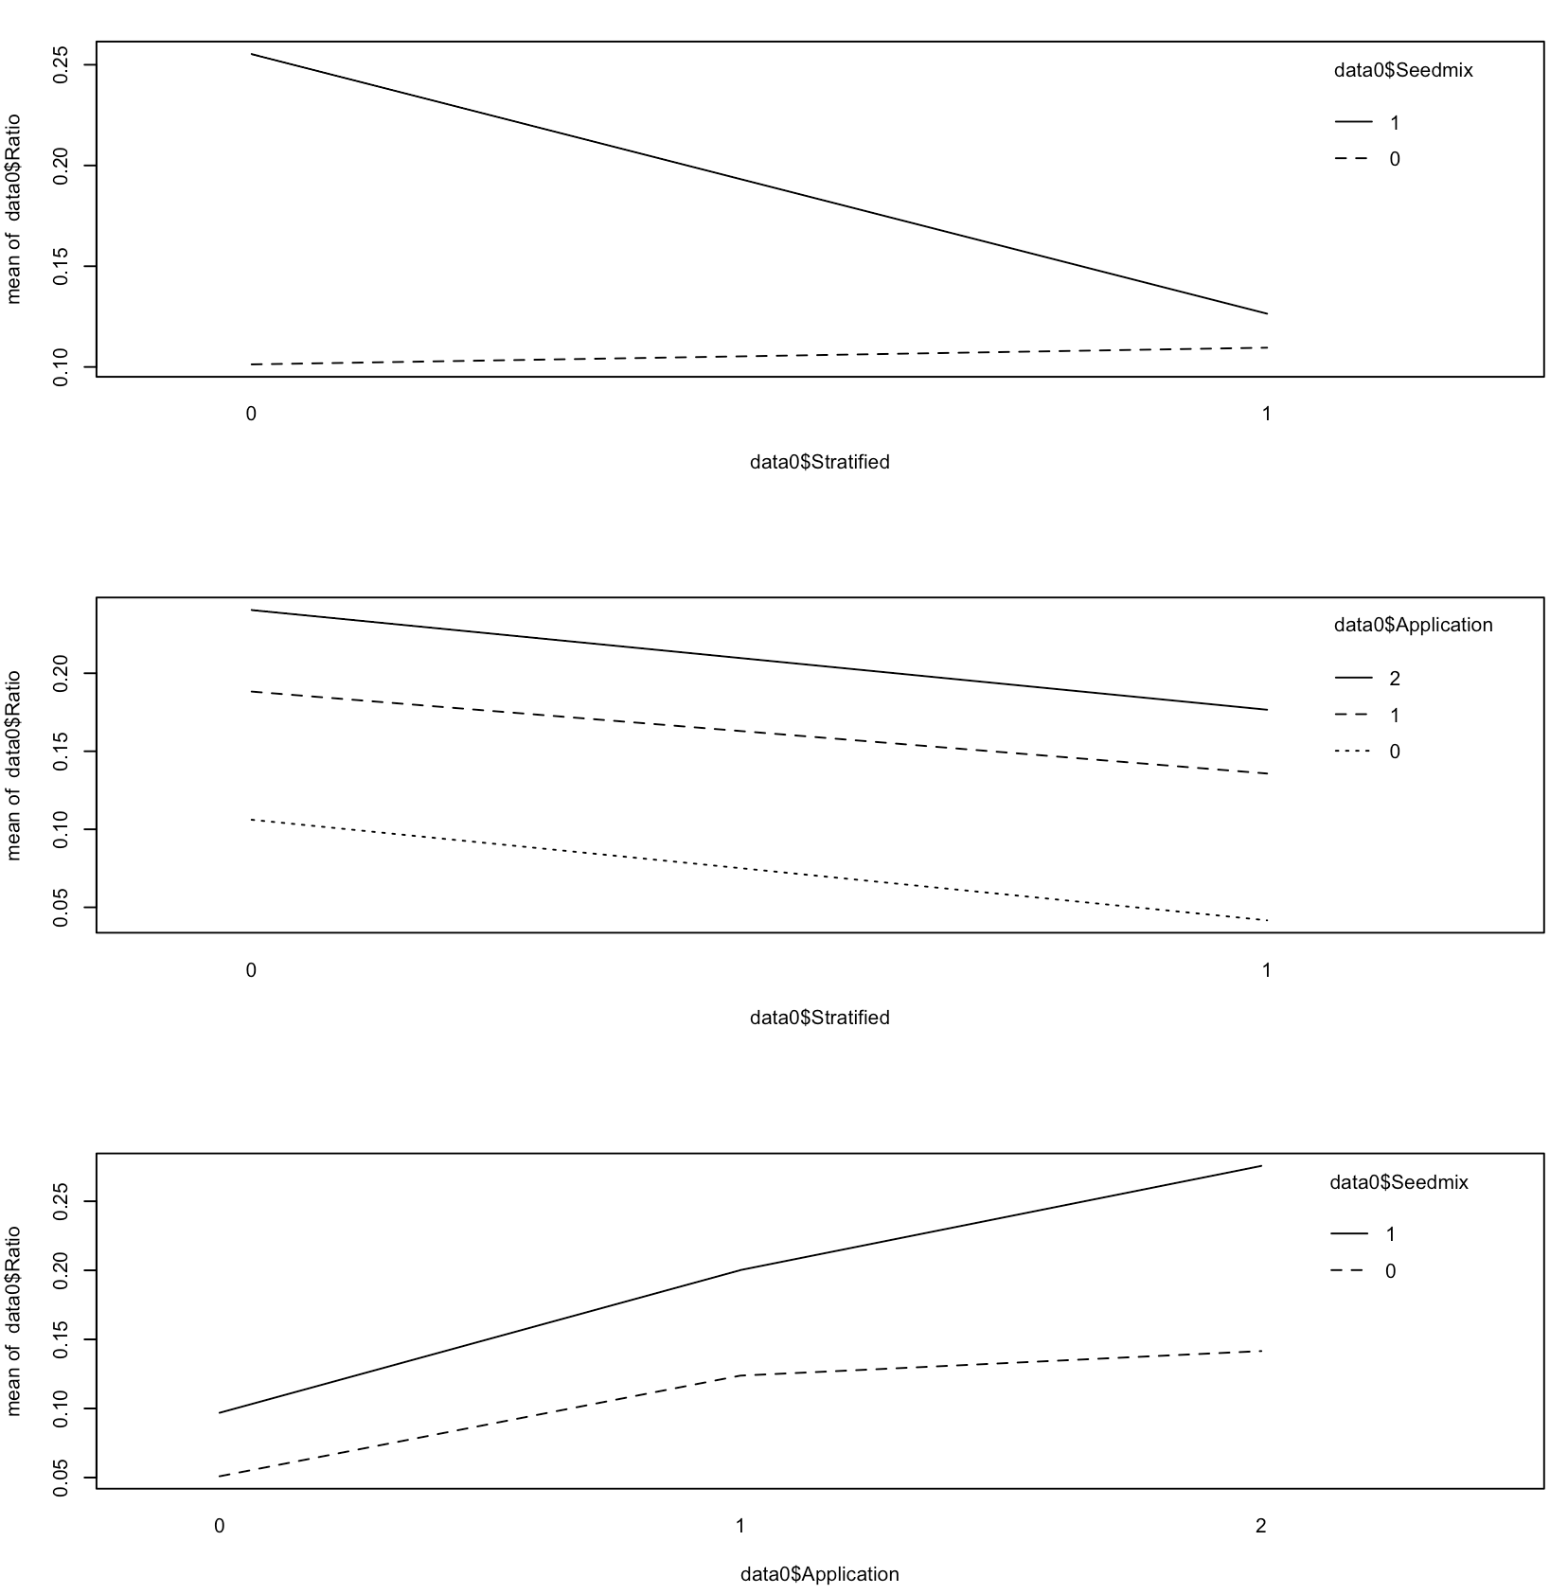
Aug
Fixed-effects ANOVA
Ratio ~ Stratified +
Seedmix +
Application +
Stratified:Seedmix
two-way combinations of factors

Slide 26
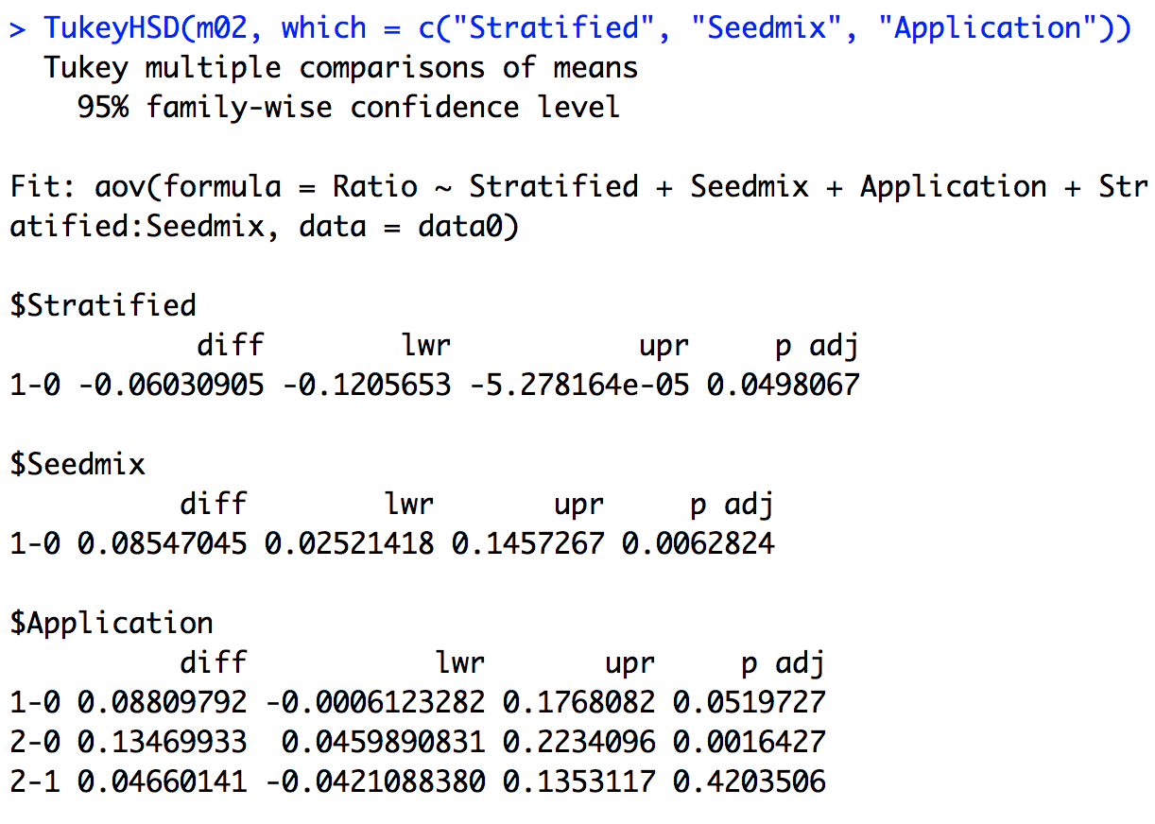
Aug
Tukey multiple pairwise-comparisons
Fixed-effects ANOVA
Ratio ~ Stratified +
Seedmix +
Application +
Stratified:Seedmix

Slide 27
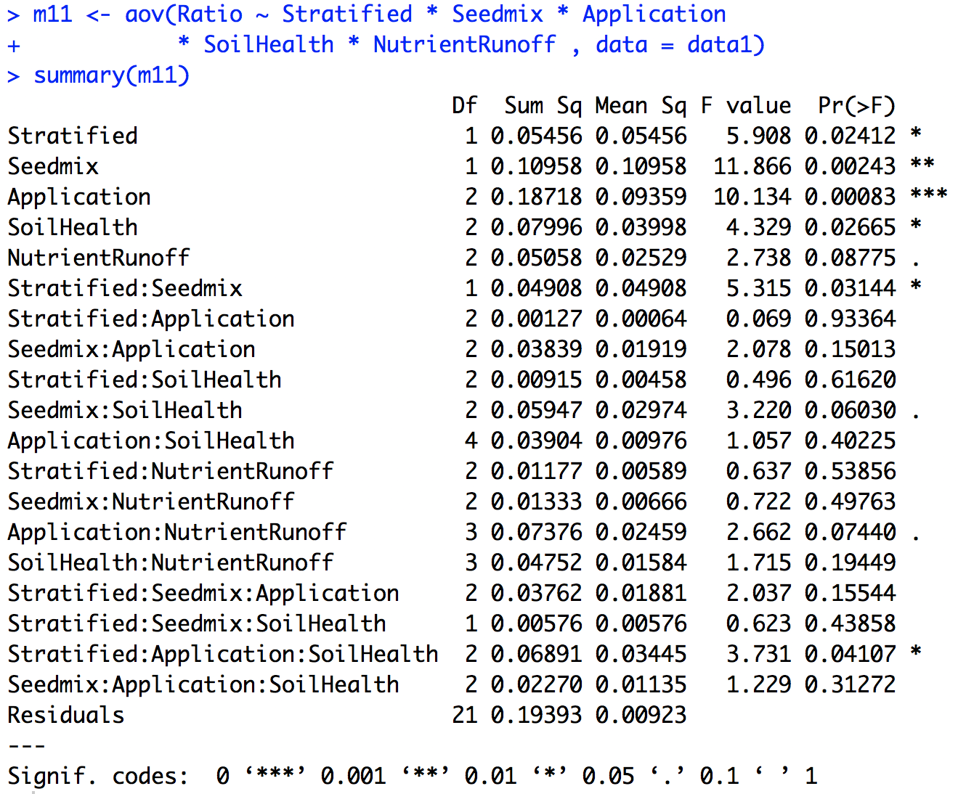
Aug
Fixed-effects ANOVA
Include soil condition.

Slide 28
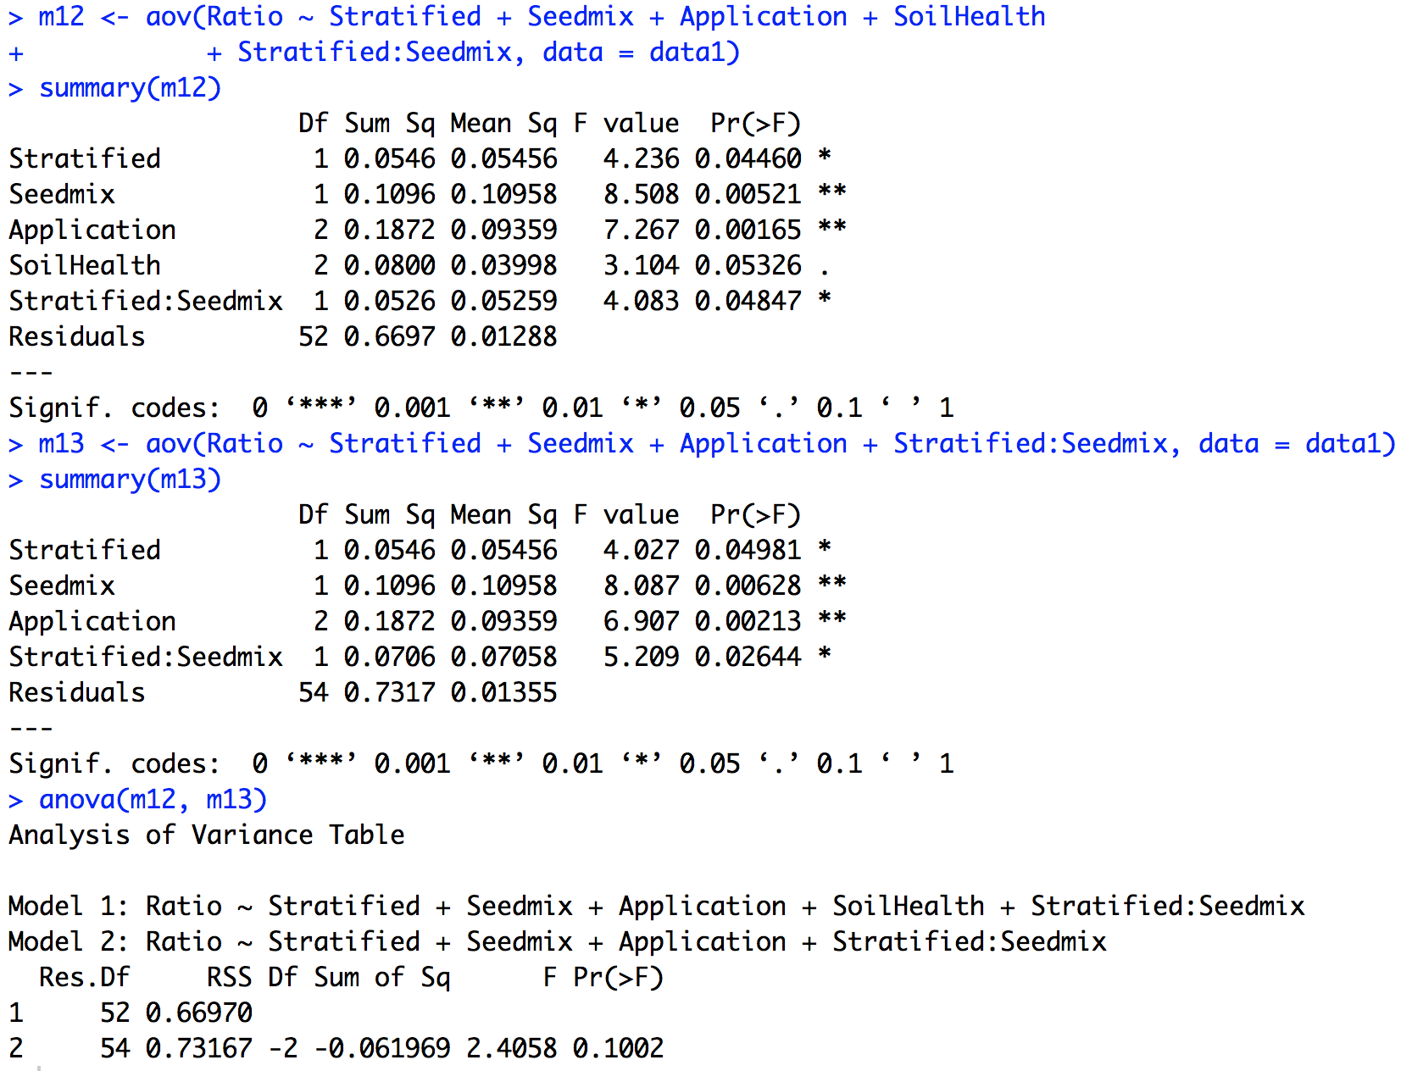
Aug
Fixed-effects ANOVA
Include soil condition.
Ratio ~ Stratified +
Seedmix +
Application +
Stratified:Seedmix

Slide 29
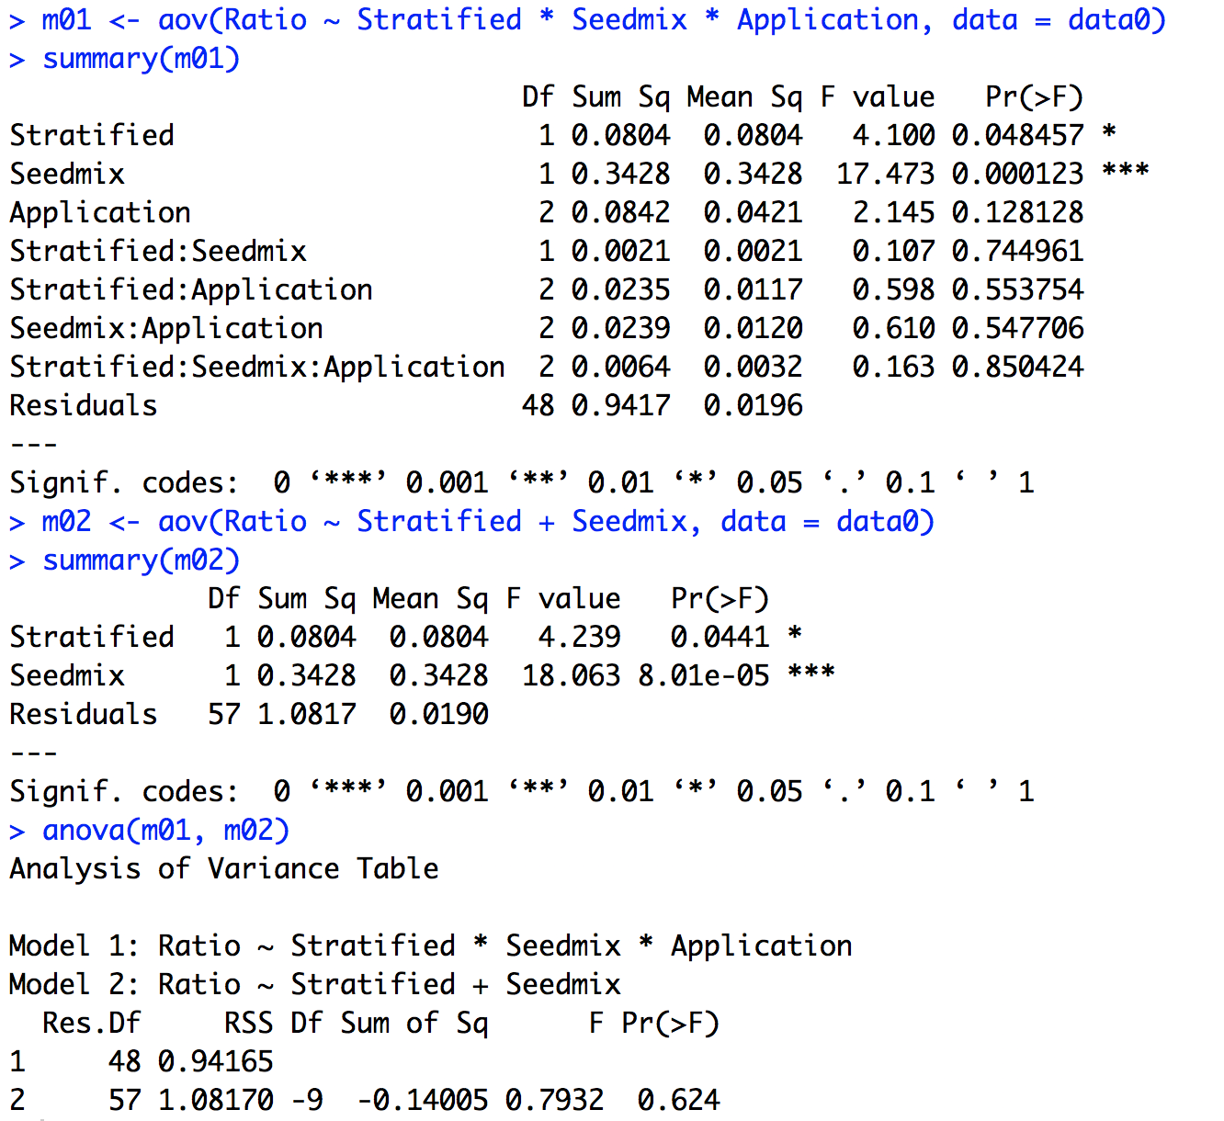
Oct
Fixed-effects ANOVA
Ratio ~ Stratified +
Seedmix

Slide 30
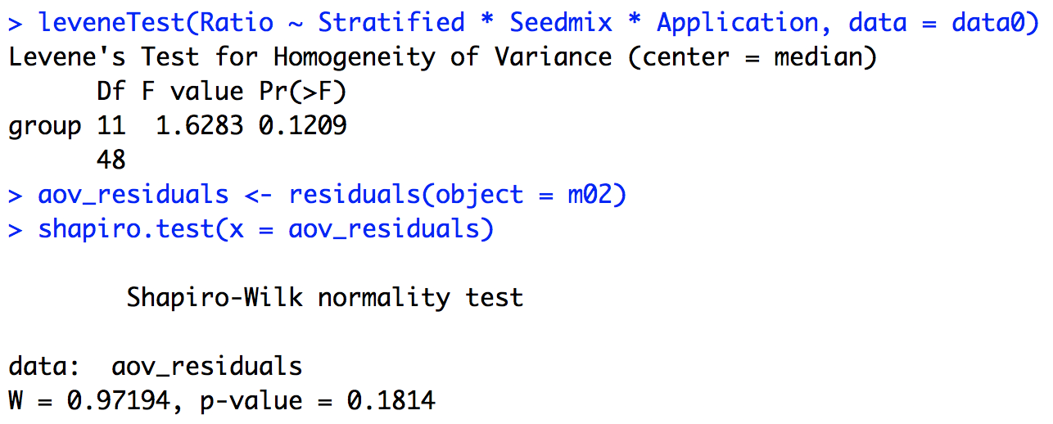
Oct
Fixed-effects ANOVA
Assumptions:
Homogeneity of variance
Levene test
Normality
Shapiro-Wilk test on the ANOVA residuals

Slide 31
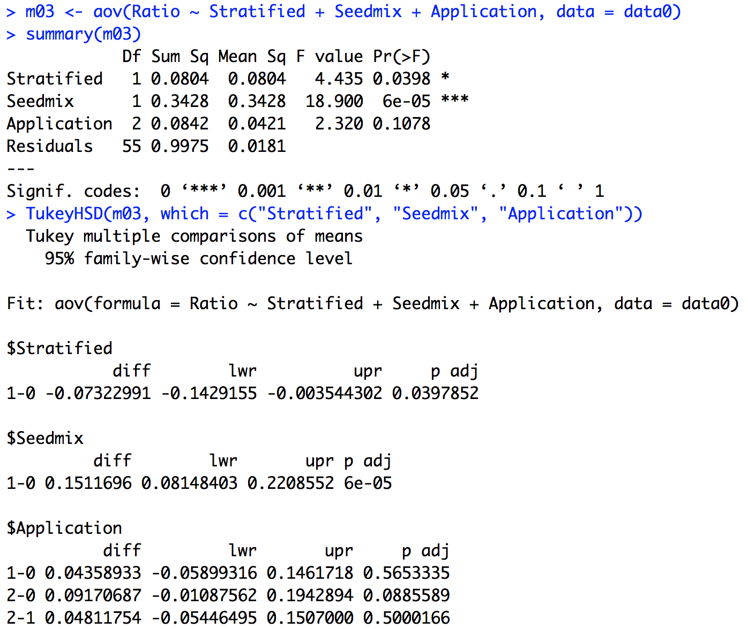
Oct
Fixed-effects ANOVA
Application?

Slide 32
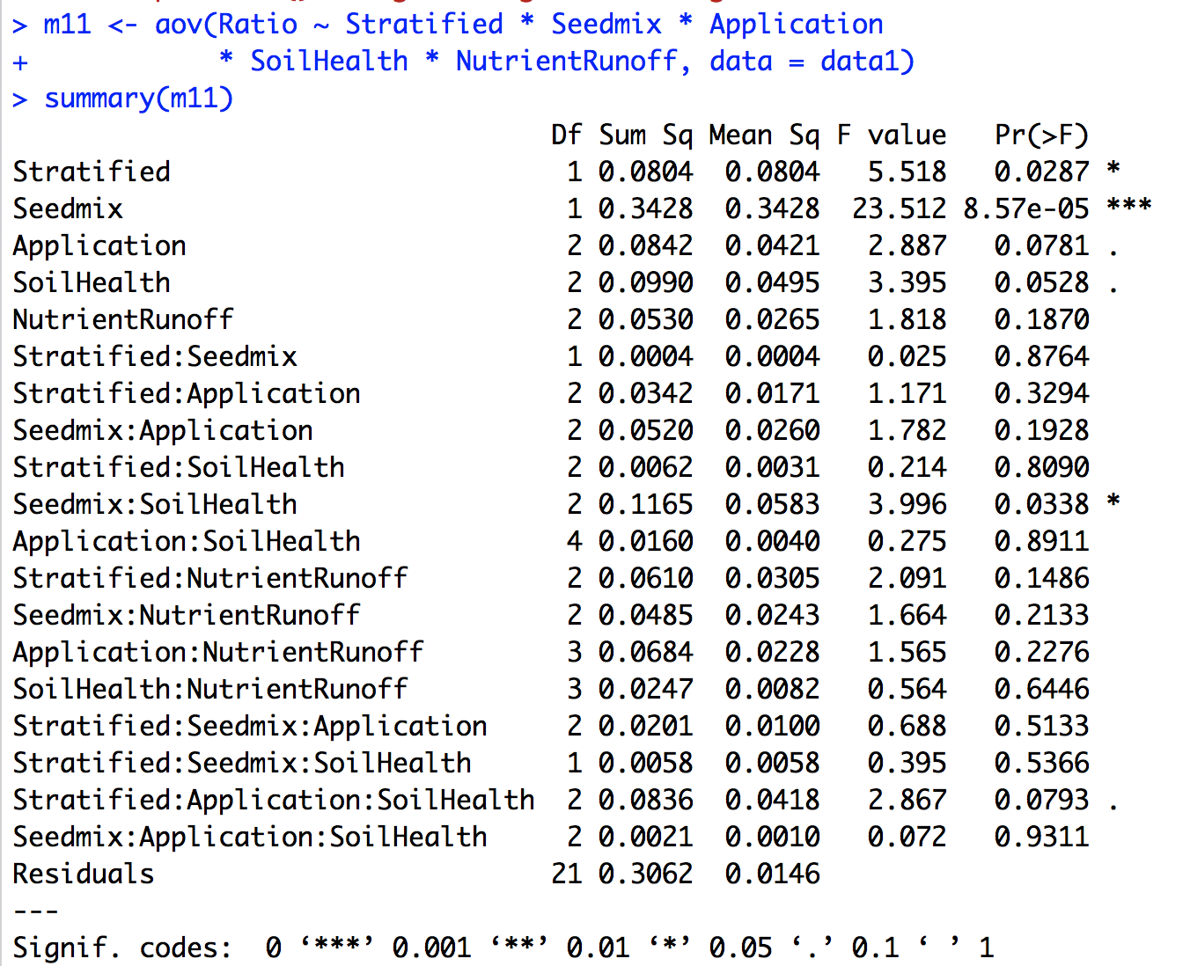
Oct
Fixed-effects ANOVA
Include soil condition.

Slide 33
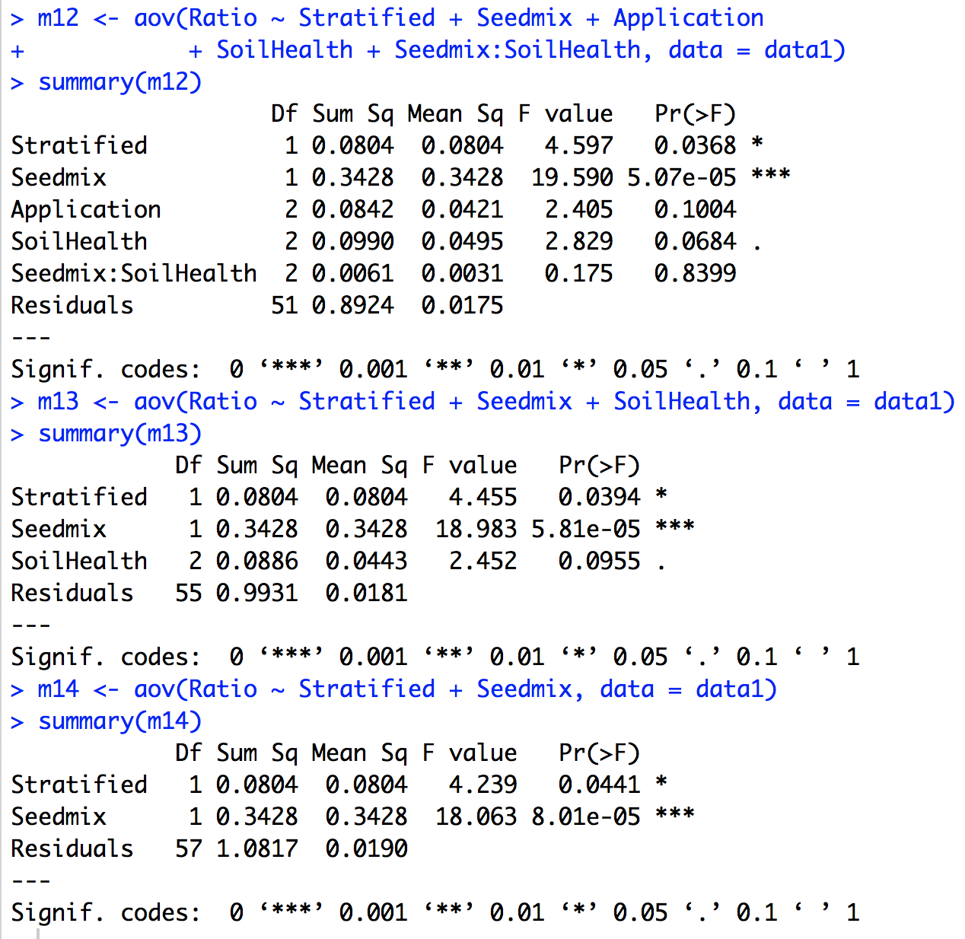
Oct
Fixed-effects ANOVA
Include soil condition.
Ratio ~ Stratified +
Seedmix

Slide 34
 | June | Aug | Oct
Stratified 1-0 | ✌ | ✌ | ✌
Seedmix 1-0 | ✌ | ✌ | ✌
Application 1-0 |  | 0.052
Application 2-0 | ✌ | ✌ | 0.089
Application 2-1 | ✌

Slide 35
Visualization
4

Slide 36
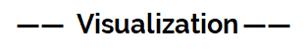
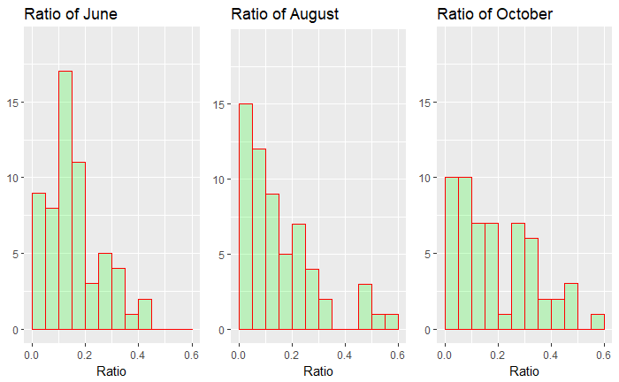
Check the distribution of response variables

Slide 37
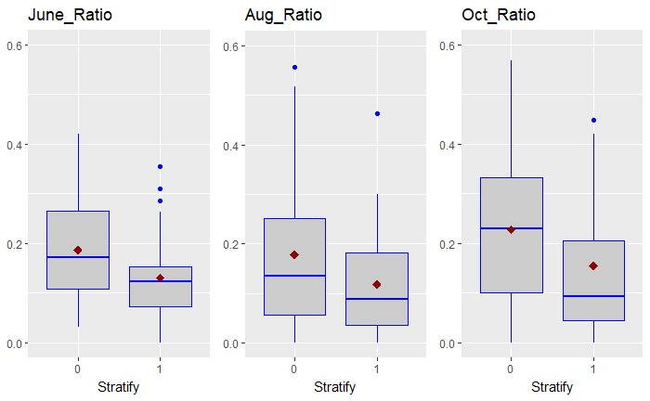
The Effect of Seed Treatment
0: No Stratification
1: Cold Stratification

Slide 38
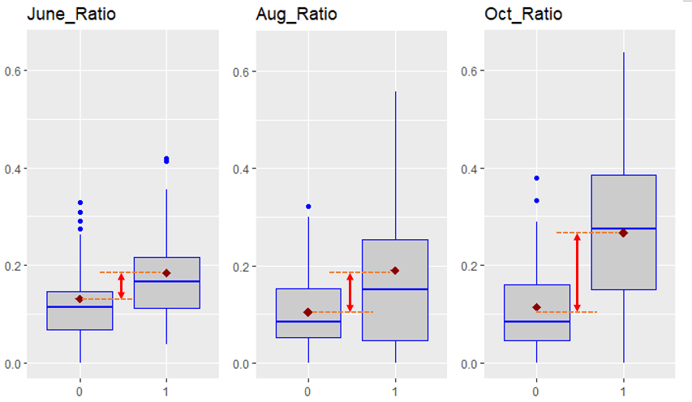
The Effect of Seed Mixes
0: Traditional pollinator seed mix
1: Plateau-tolerant pollinator seed mix

Slide 39
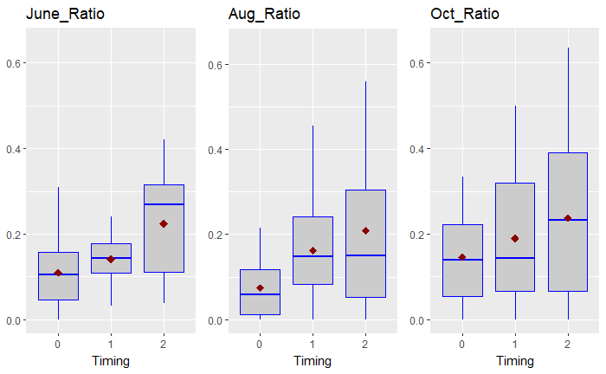
The Effect of Timing
0: No herbicide application
1: Pre-emergent application
2: Post-emergent application

Slide 40
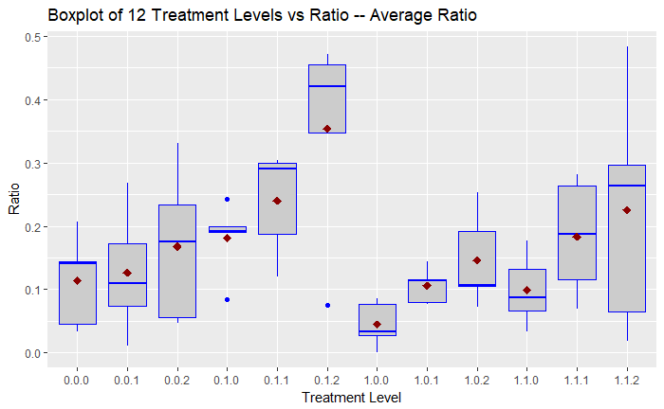
0.1.2:
No stratification,
Plateau-tolerant pollinator seed mix, Post-emergent application
1.1.2:
Cold stratification,
Plateau-tolerant pollinator seed mix, Post-emergent application

Slide 41
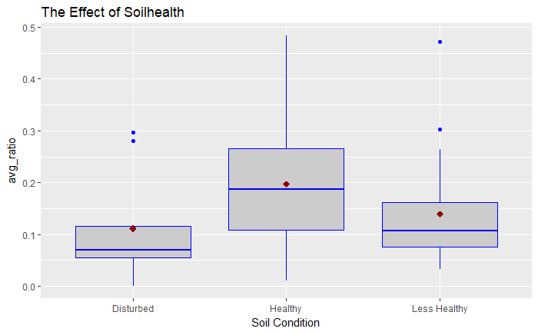
The Effect of Soilhealth

Slide 42
Conclusion
5

Slide 43
The results of experiment
For cold stratification:
Cold stratification performs poorly during the process
For seed mixes:
Seed mix with imazapic application performs better than traditional seed mix, which results in significant increase of the ratio
For timing of application:
Post-emergent application performs better than pre-emergent application and no application

Slide 44
Thanks!
Any questions?

